Slide 1
SOLID Design Principles
The Underlying Theory of Design Patterns in Code
Now with extra memes!

Slide 2
What is SOLID?
Introduced by Robert “Uncle Bob” C. Martin
Five principles that undergird good object-oriented design (OOD)
Not the only 5 principles of good design, but more specific to OOD
For example: DRY (Don’t Repeat Yourself), KISS (Keep It Short & Simple)
Single Responsibility Principle
Open/Closed Principle
Liskov Substitution Principle
Interface Segregation Principle
Dependency Inversion Principle
Bonus – Composition Over Inheritance Principle

Slide 3
Single Responsibility Principle
A class should have one and only one reason to change, or job to do.
Easier to remember: Single Reason to Change Principle
This isn’t always easy to pin down
Defined too narrow means an explosion of classes
Defined too wide means inflexible spaghetti-code
Find the Goldilocks-zone depending on your need
Use nested, local, derived classes, etcetera, to organize related behavior
Warning signs:
Using conditionals (if/then/else/switch) for changes in behavior
Functions that operate on different subsets of inputs or members
Static functions that aren’t used in conjunction with instance functions

Slide 4
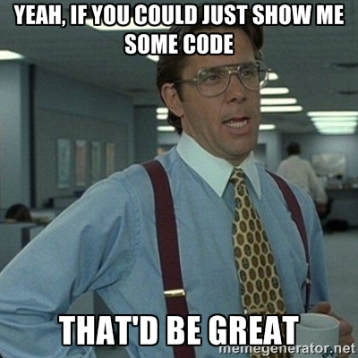
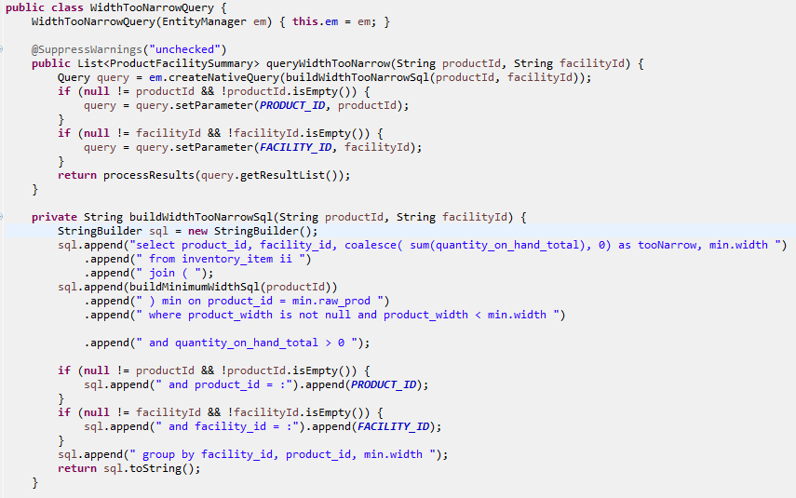

Slide 5
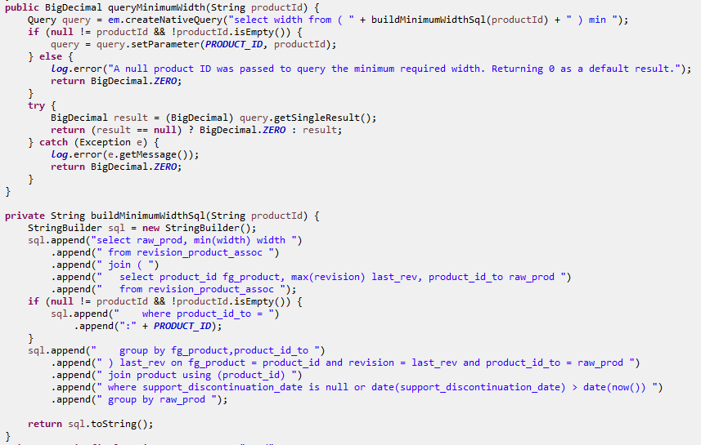

Slide 6
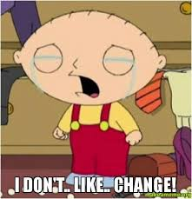
Open/Closed Principle
Open to Extension and Closed to Modification
Prefer changing code by adding classes/functions over modifying existing ones
The goal is not to prevent ever changing code, but rather to motivate the consideration of how the code should be changed by future development.
Designer plans ahead for future maintenance or elaboration while closing down avenues that would only complicate the design.
This is very important for library design where the source is unavailable
This can also be a good principle to adhere to when changing existing code.
Create a new function or class which is called by the old code
It’s not possible to be open to all change
Too open to change and code will be difficult to understand how to change
Too closed and maintenance will require much more retesting
Goldilocks zone is to design for anticipatable change vectors

Slide 7
Open/closed principle
Possible example vectors of change, aka polymorphism:
Composition Change Pattern
Change the objects a class is composed of in order to change behavior
Common workflow used by different types with a common interface
Algorithm can change internally to execute custom functionality
Change a dog to a cat by surgically changing their parts
Ex. Strategy, Decorator, Functional Objects
Inheritance Change Pattern
Common code needs to be shared with highly similar types (access pattern is moot)
Code can change before or after or replace a common function
Change a dog to a cat by breeding a cat-like dog
Ex. Builder, Facade, Wrapper, Interfaces
Template or Generic Change Pattern
Similar to composition but without requiring strict adherence to an interface
Code changes according to a type that defines the access pattern
Change a dog to a cat by creating a cat suit for your dog
Design Patterns generally originate from combinations of these principles

Slide 8
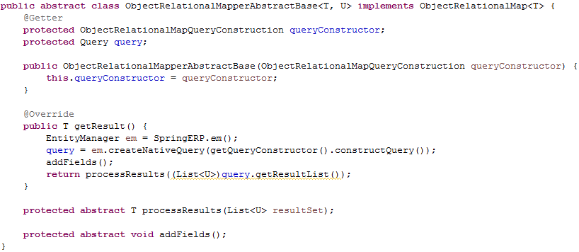
This example uses all three vectors
Composition – the query constructor is used by the get result function
Inheritance – it is an abstract class with functions that need to be implemented
Generic Programming – it has 2 replaceable types, T & U.

Slide 9
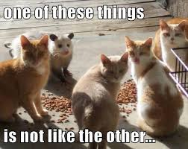
Liskov substitution principle
Like-Object Sub-Types Principle
This is a more helpful name to remember what it means
The principle pertains to how sub-classes or implementation classes behave with respect to the constraints set by fulfilling a common interface
Behaviors that violate those constraints will create a need to write code for special cases outside of the sub classes to handle aberrations
In other words, it will not be possible to blindly substitute one class for the other
The constraints might not be well documented and merely implied by naming or tribal knowledge of the system, or require familiarity with other implementations
Observing the Single Responsibility Principle can help avoid violation
Keeping classes simple avoids possible aberrations by design
Observing the Open/Closed Principle can help
Avoiding change on an established class will prevent introduction of differences
If it isn’t possible to avoid violating the principle, recheck your design approach

Slide 10
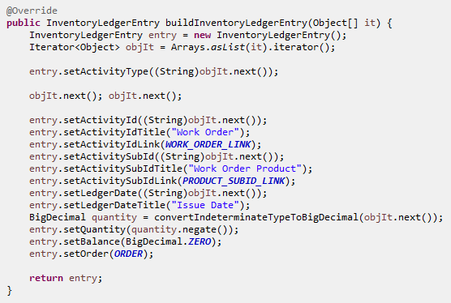
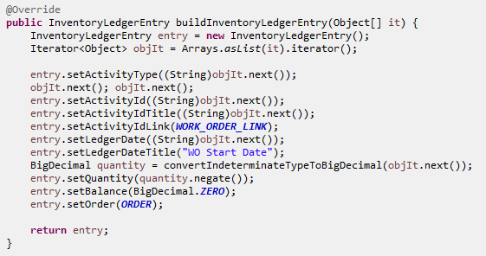
Each implementation of InventoryLedgerConstruction must observe the same constraints and produce an InventoryLedgerEntry object with similar expectations.

Slide 11
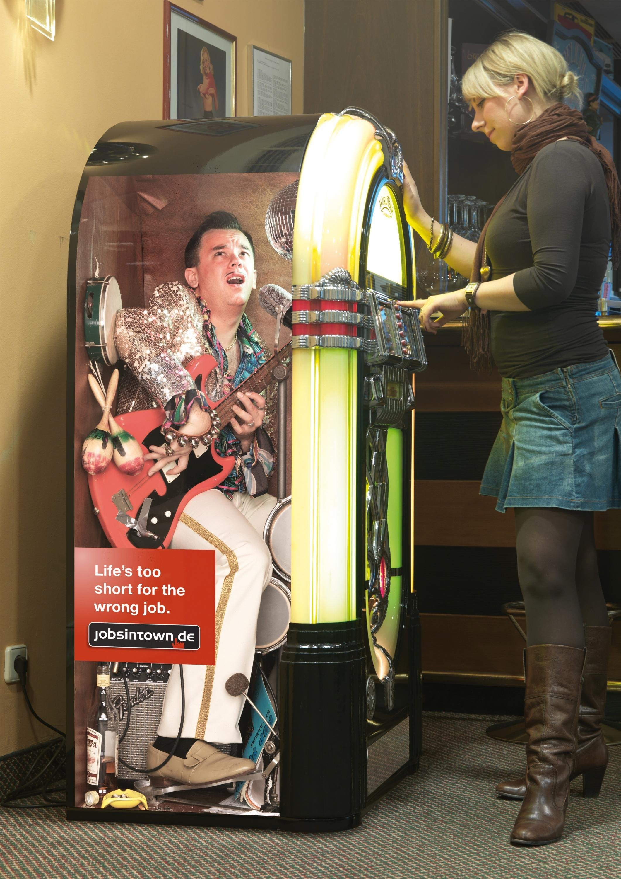
Interface segregation principle
Talk to the interface because the implementation is encapsulated!
Creates a documented contract between client and implementation code
This principle is a major part of ensuring the correct use of the others
SRP – an interface should be singular in its responsibility, enables division
Open/Closed – an interface helps indicate possible vectors-of-change freedom
Liskov – interfaces are documentation of implementation expectations
Dependency Inversion – more on this later, but DI depends on IS to work
When are interfaces not needed?
When the implementation class would change along with its client class
Essentially, in cases where SRP is important, but other principles aren’t
Otherwise, always be utilizing objects via an interface, not an implementation!
Every Design Pattern uses interfaces to accomplish the pattern goal

Slide 12
These two interfaces are used by the ObjectRelationalMapperAbstractBase shown earlier.
The first defines the way that this class is used by its clients and the second defines how it will use classes it interacts with.
The getter for queryConstructor satisfies the implementation of the InventoryLedgerConstruction interface in ledger implementation classes
These aren’t the only interfaces used by the class, however. Can you count the number of interfaces? What are they?

Slide 13
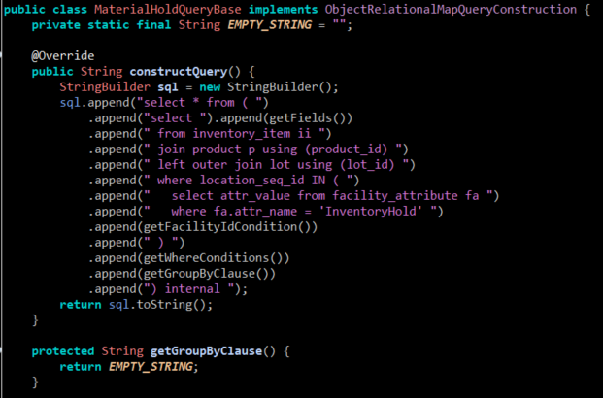

Slide 14
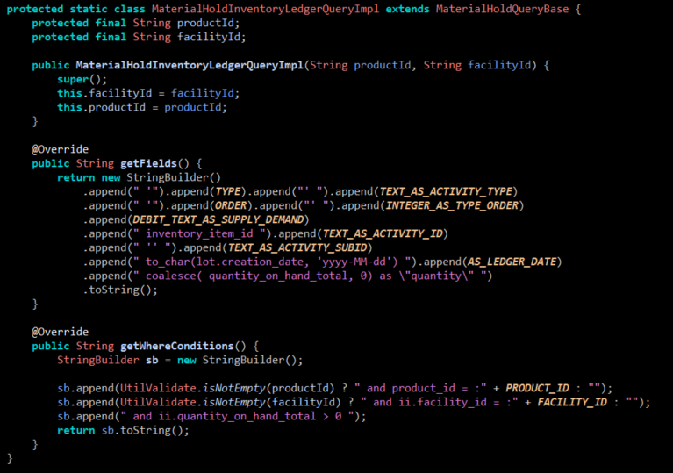

Slide 15
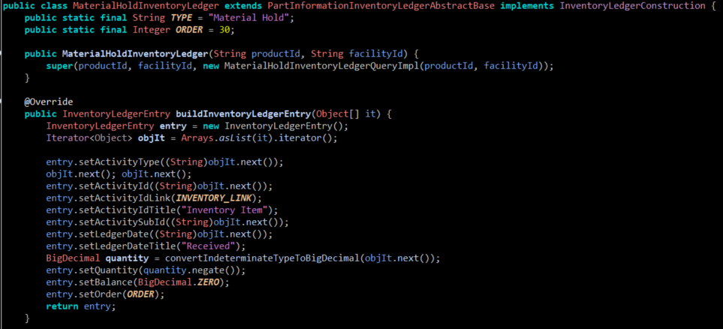

Slide 16
Dependency injection principle
AKA – Inversion of Control
The Flux Capacitor of programming - it’s what makes good design possible
In order to satisfy the requirements of Open/Closed & Interface Segregation
No class should instantiate the non-local objects they depend on
Quiz: Explain how does DI help satisfy Open/Closed?
Dependencies should satisfy Liskov principle
Instead, implementation objects should be provided to the class through constructors or setters by way of Factory Methods or Abstract Factory classes
This principle makes it necessary to have a way of ‘wiring’ classes together at startup as well as during run-time
There are various frameworks that provide easy wiring specification
Most common one is Spring with the use of @Autowired & @Bean annotations
Warning sign – instantiation with a ‘new’ operator, especially to an interface

Slide 17
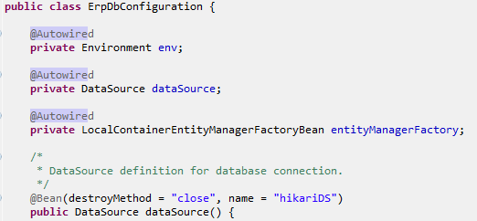
This is a fairly simple example of how our code is using Spring’s dependency injection capability to enable the automatic wiring of classes together.
Midh’s new code uses it much more heavily

Slide 18
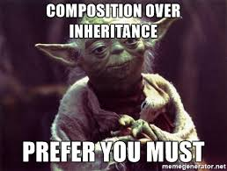
Composition over inheritance principle – Bonus round
Composition of classes is preferred to inheritance for object-oriented design
Inheritance means that a derived class IS-A type of the parent
Quiz: How might this violate Liskov Substitution, Open/Closed, SRP, etc…?
So, only use inheritance when it is a SOLID choice ;)
Composition more easily fits with the SOLID principles
Means that one class HAS-A different class as part of its design
Allows greater flexibility in handling change vectors
Quiz: How have the examples presented earlier utilized this principle?
Why might you choose inheritance?

Slide 19
Application Challenge!
Design a generic board game engine
Must be capable of governing the actions of 2 or more players
One of the players could be a computer player
But not expecting to design computer player logic in this challenge
Game board can be any type where game pieces are moved from one position to another on a turn by turn basis.
Ex. Checkers, chess, Monopoly, Sorry, Candyland, Life, Clue, Chutes & Ladders
Players can have one piece or many pieces
Game will be controlled by classes which govern the rules
But only minimal game logic as needed
Pick 2 games such as Checkers or Candyland as examples
Describe each class’
Single responsibility
If it is able to change behavior (composition, sub-classing, template)
Assumptions about base class and sub-class behavior
Interfaces being used
Dependencies on other classes
Think about these issues and we will develop a design together next meeting
Don’t try to solve the whole problem, just design as much as you can imagine

